Slide 1
eureka
NER900
S9E
Source From: Nico Ren
Speaker: Felix
Speaker name and title
Notes:
The robot has bot lunch yet,
but it is still very important to know it first.
Mainly focus on the product itself

Slide 2
Contents
NER900
01
02
03
Appearance design
Core Selling points
Secondary selling points

Slide 3
01
Product appearance
NER900
Notes:
In the first part, I will introduce the appearance of the S9E.
And with some comparison with the other product.

Slide 4
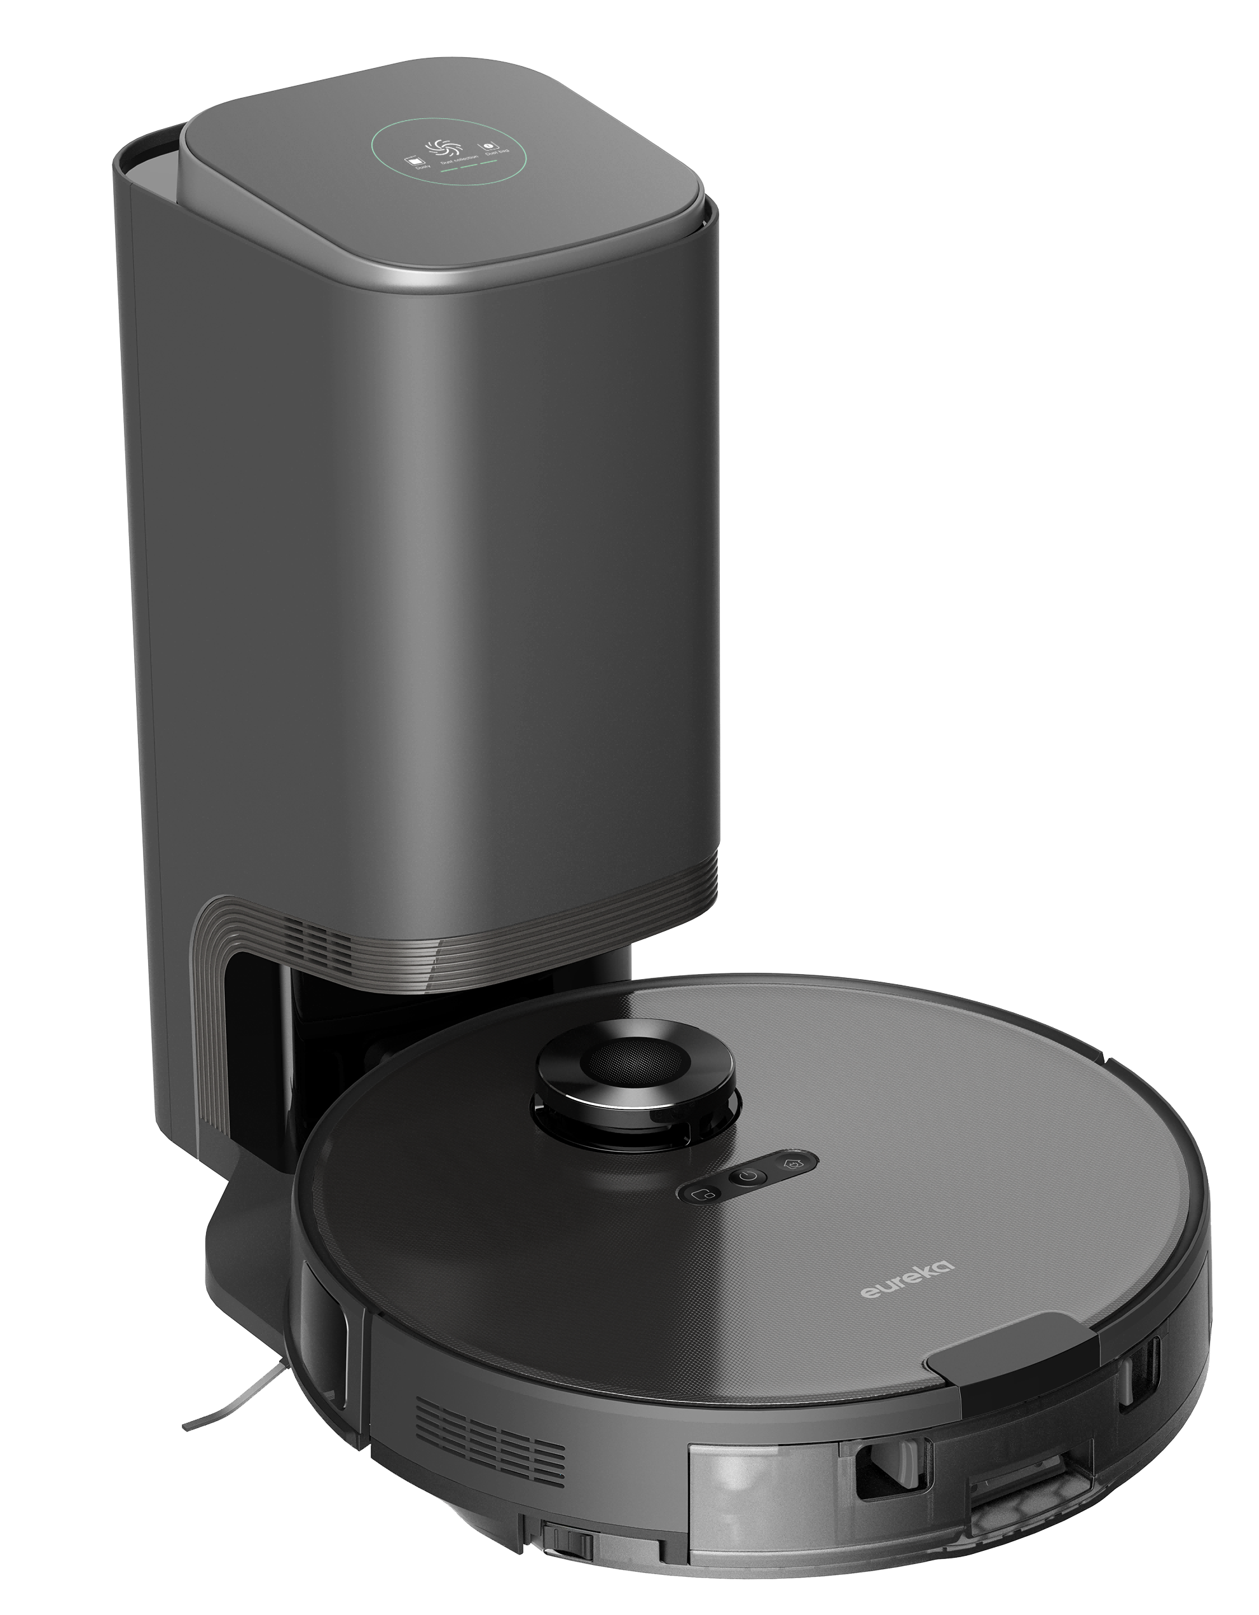
NER900 Product appearance
Screen
Release button
Dust collect station:
Recharge signal transmitting area
Power button: Tap to turn on the robot
Navigation module：LDS navigation, accurate mapping
Water tank with auto-lifting mop：
Stable water output, automatically lift the mop as encountering the carpet
Dust collecting pipe：
Differ from the S8+, S9e collect dust at the back of the machine
Notes:
Dust collect station: Charging & dust collection
Screen：shows whether the station is On/Off，dust collecting data and hints errors
Release button：Tap to release the cover plate
Recharge signal transmitting area

Slide 5
02
Core selling points
NER900

Slide 6
Sore points to solve

Slide 7
1.
Cleaning dust is easy to get your hands dirty, wanna free your hands？

Slide 8
S9E series adopts a new post-extraction dust collection, cleaning rate over 90%, finish dust collection within 9 sec, free your hands and care for family health.
Equipped with 700Watt high-power motor, 19,000Pa strong suction, rapid dust collection.
2.5L large capacity dust bag, multi-layer sealing, no need to change for 30 days, automatically collecting dust, reminder for full dust

Slide 9
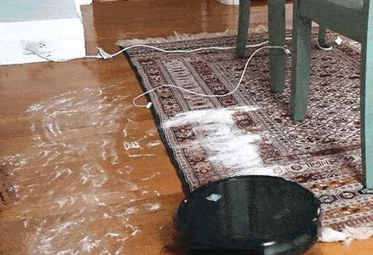
2.
Difficult to remove stubborn stains
Distributing water on the carpet
Mop cannot be cleaned in time, which could do damage to the wooden floor

Slide 10
Enhancing Pressure Downward
Enhancing pressure for 4N to remove stubborn stains
Auto-lifting Mop
Auto-lift the mop when encountering the carpet and strengthen the suction
Lifting the mop when charging

Slide 11
"Lifting" over obstacles, enhancing the ability to get out of trouble
"Lift" anti-slip, walking smoothly
"Lift" charging to avoid secondary pollution of the floor
"Lift" to stand by, the mop is ventilated and odor-resistant, no moisture-proof pads required

Slide 12
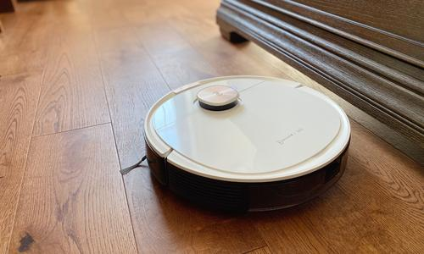
3.
Not smart enough &
Need additional help？

Slide 13
New generation LDS navigation
With 5th generation of LDS navigation system, the S9e can map the whole house and recognize the obstacles within one cleaning
Supports Linear Laser
Catch the 3D outline of obstacles
High precision of obstacle avoidance
Strong resistance to the visual light

Slide 14
03
Secondary selling points
NER900

Slide 15
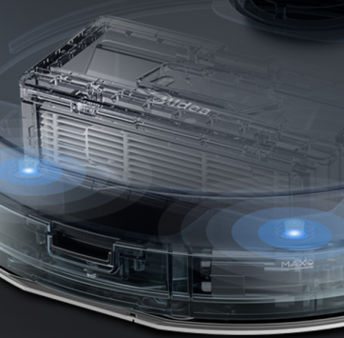
Care for details
Dust Bin Detection
Triple Filtration
Filter fine dust and allergens to reduce the risk of allergy
Sensors will detect whether the dust bin has been installed or not to prevent blowing out dust

Slide 16
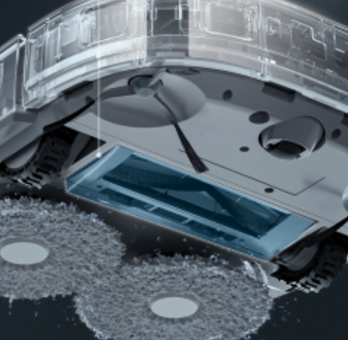
Care for details
02
Anti-skid tires, easy to cross obstacles no higher than 2cm
Slim design of 9.75cm，easy to clean every corner
01
With 38 groups of sensors, detect the environment omnidirectionally

Slide 17
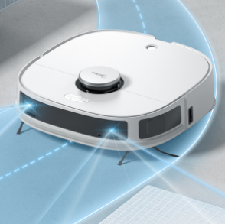
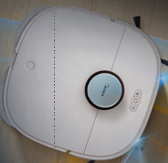
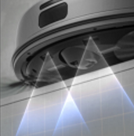
Care for details
06
LDS+linear laser
Scan the environment omnidirectionally
05
Smart Edge Cleaning
The side brush is able to touch the corner line
No collision with the wall
04
Anti-fall Design
With the anti-fall sensors
Cliff is not a worry for the robot

Slide 18
Thanks

